Slide 1

Project Title :
Smart Cleanup Assistant
Elevate Your Workspace

Slide 2


Prepared By
Jash Naineshkumar Adalja
Enrollment No –> 22002171310002
Branch –> Computer Science Technology
Batch –> C4
Roll No –>126
Website –> JASH ADALJA

Slide 3
Project Outline :
01
03
02
04
Introduction
Merits And Demerits
brief overview of project
discuss the advantages and disadvantages of project
Future Scope
Functionality
described the key functionalities of project
outline potential future enhancements or extensions of project

Slide 4
INTRODUCTION :
Smart Cleanup Assistant made for PC and laptop users using python.
With an intuitive GUI, this Python-based tool offers seamless deletion of duplicate and large files, alongside intelligent file organization, streamlining your digital workspace effortlessly.

Slide 5
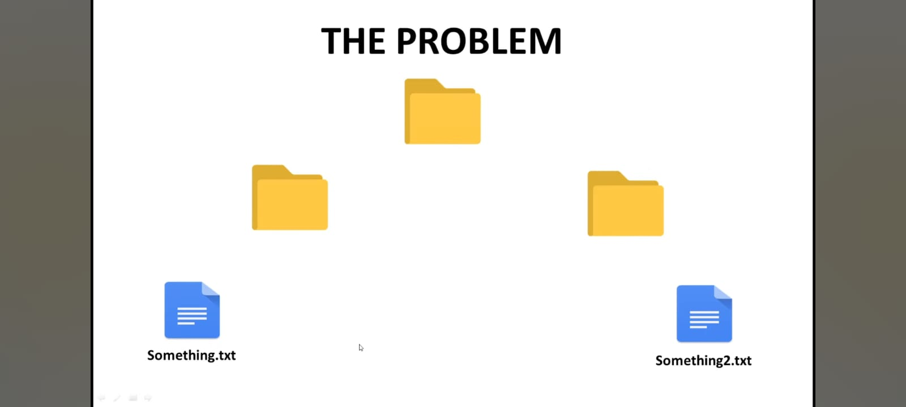

Slide 6
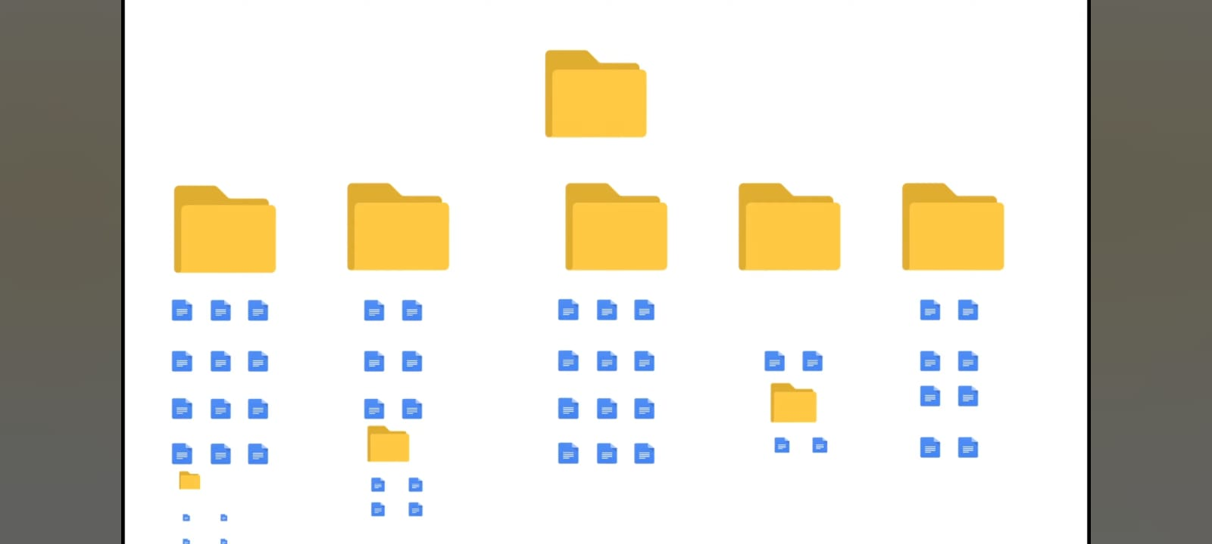

Slide 7
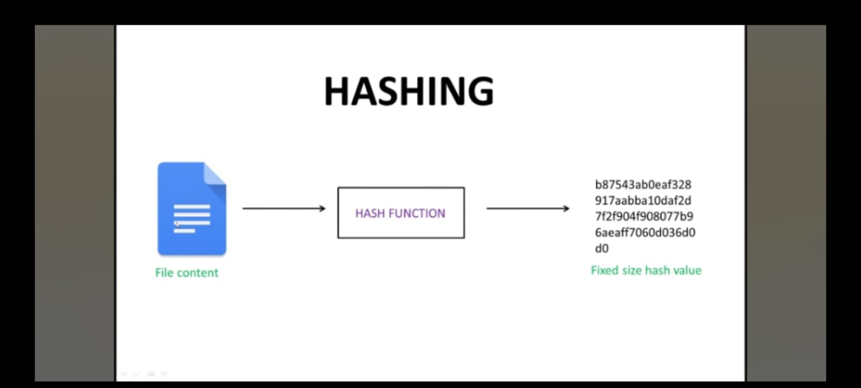

Slide 8
Functionalities :
Saves disk space by eliminating redundant copies of files.
Detects and deletes large files that consume significant storage space.
Duplicate File Deletion :
Large File Deletion:
1
2
3
4
Graphical User Interface :
Intelligent File Organization:
Automatically organizes files based on predefined file type
Intuitive interface for easy navigation and user-friendly experience.

Slide 9
Merits : Demerits :
Improved Performance
Files Organization
Space Optimization
User-Friendly
No Backup Stored
The project may occasionally experience technical glitches.

Slide 10

Future Scope :
We can implementing machine learning algorithms to enhance the tool's ability to automatically identify and categorize files for cleanup
We can integrating with cloud storage services to provide users with the option to offload and manage files stored in the cloud

Slide 11



THANK YOU!
Do you have any questions?
Please keep this slide for attribution
Contact Me On -> JASH ADALJA
jashadalja12@gmail.com

